Slide 1
Spatiotemporal modelling & automated in-situ sensors to monitor Harmful Algal Blooms(HABs) Case Study-Lake Victoria
Presenter:
Name: OKELLO, JACOB OKOMO
Reg. No: ENC222-0149/2017
Progress Presentation

Slide 2
Introduction
HAB is a phenomena which turns water bodies dark blue-green due to eutrophication; potentially harming humans and animals e.g., massive fish deaths, etc. Which has been lately observed in L. Victoria riparian reserves due to eutrophication in the region. (Hecky et al., 2010)
Development, stability, and density of the phenomenon affect some environmental factors Lake Surface Air Temperature (LSAT), Sea Surface Temperature (SST) (Tang et al, 2006)
In spite of being potentially harmful to the locals, the status quo only provides for the higher authority to solely rely on calls/information from the local residents after the condition is a total mess without relying on any near real-time space-based or in-situ monitoring system.
Therefore, there’s need to come up with a quick response methodological approach to use space-based techniques and in-situ sensors to detect and alert the near-real time occurrence of HABs
Coupling wide spread spatiotemporal monitoring, and automated in-situ system will play a big deal in return. This would inform the Govt. and the general public the affected zones, calling for immediate remedy actions.

Slide 3
General and specific objectives
To detect, monitor and report the occurrence of Harmful Algal Blooms(HABs) in Lake Victoria, Kisumu basin.
To monitor chlorophyl-a(chl-a) concentration from L8 OLI images.
To monitor Lake Surface Air Temperature(LSAT) from L8 TIRS images as another HAB indicator in L. Victoria.
To develop automated Internet of Things (IoT) in situ sensors, Applicable in near real-time to monitor and report geo-tagged Water quality data.

Slide 4
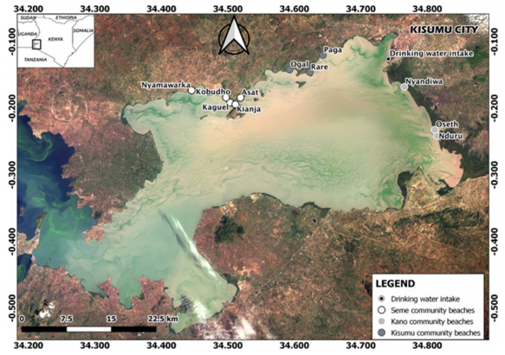
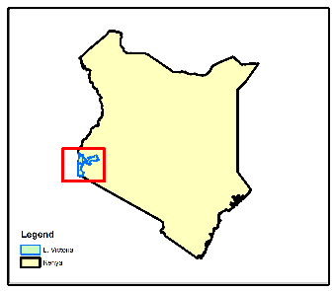
Study Area
NYANZA GULF
Homabay

Slide 5
Data and Materials
Data Type | Source | Role/Use
Landsat 8 OLI (30m, 16 days) | USGS (2015-2021) | Spatiotemporal HAB Monitoring
Landsat 8 TIR (100m, 16 days) | USGS (2015-2021) | Lake Surface Water Temperature Monitoring(LSWT)
Field Data | Kenya Marine & Fisheries Research Institute-KMFRI (2015-2021) | Previous HAB events
In-Situ Data | In-situ Sensors 2021 Onwards | Continued In-Situ Algal Monitoring
Tool/Material | Role | Availability
Google Earth Engine (GEE) | Geocomputation & Processing | Freely Available
ArcMap, R & Python | Further Analysis & Maps | Free
Microcontroller & Sensors | In-Situ data Monitoring | Local Purchase

Slide 6
Automatic L8 Acquisition from GEE
TIRS Data
Landsat 8 images
OLI Data
TIRS B10
B5 NIR
B4 RED
B3 GREEN
B2 BLUE
NDVI
TOA DN to At-Sensor Radiance(Lλ)
Proportional of Vegetation(Pv)
Ocean Color Chl-a algorithms
At-Sensor Spectral Radiance to Brightness Temp (Tb₁₀)
Lake Surface Emissivity (LSE)ε
Estimate for next available date
Validation
Estimate for next available date
Estimate Lake Surface Air Temp (LSAT)
Objective 2
Objective 1
Below
Threshold
Above
Automatic Results Download
Process validation
Spatiotemporal Monitoring

Slide 7

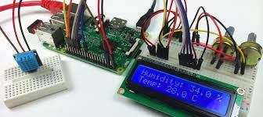


Overall methodology
Start
IoT Gateway
Ensure a secure connection via SSh
Upload in-situ data to reporter
Upload in-situ data to Processor
GPS
LSAT
Salinity Status
No
In-situ data > Temp. threshold
Objective 3

Slide 8
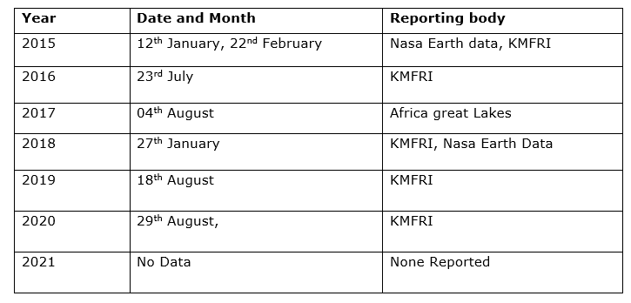
HAB reported dates, from 2015
Table 3: HABs reported in Lake Victoria, (KMFRI, NASA Earth Data)

Slide 9
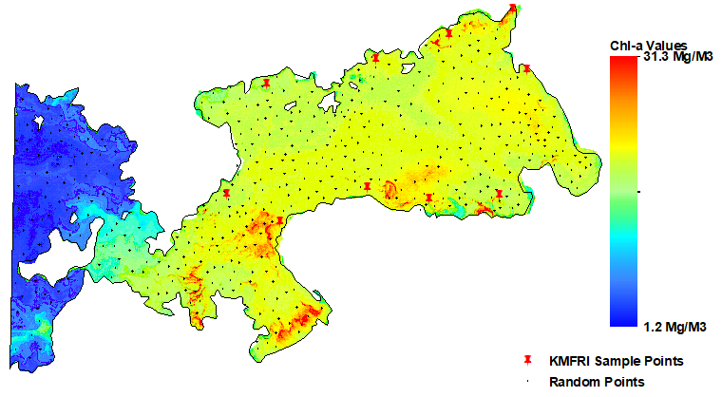
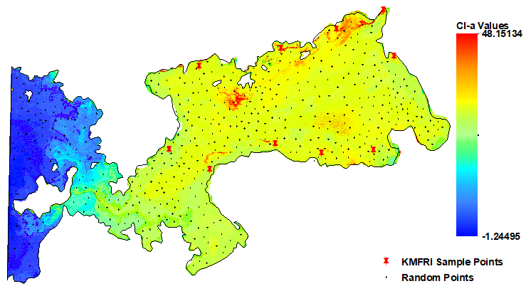
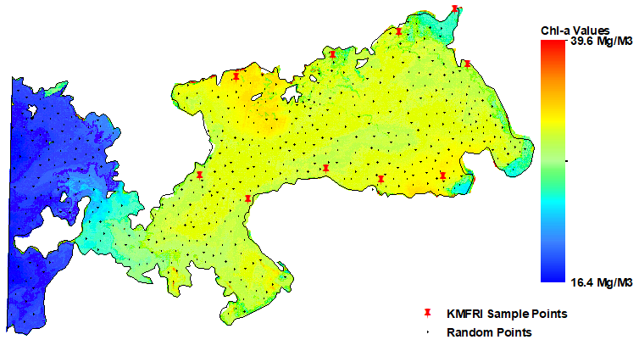
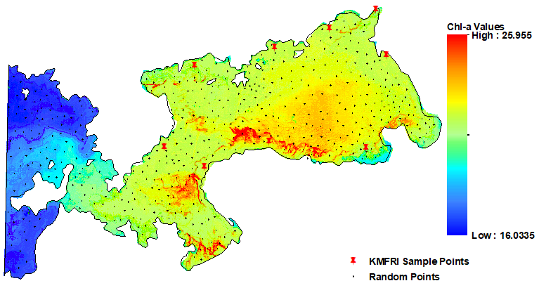
Results: Chl-a concentration maps
12th January 2015 23rd July 2016
04th August 2017 27th January 2018

Slide 10
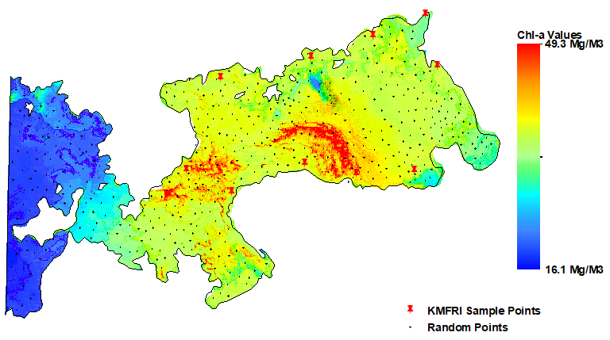
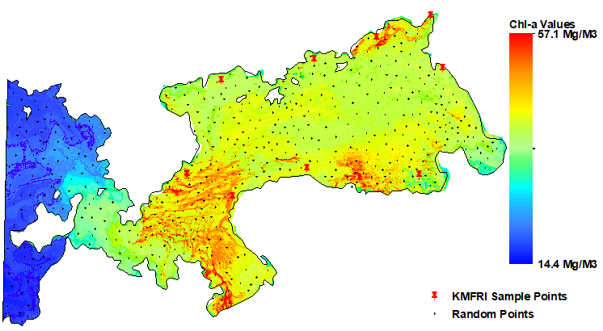
Results: Chl-a concentration maps
18th August 2019 29th August 2020

Slide 11
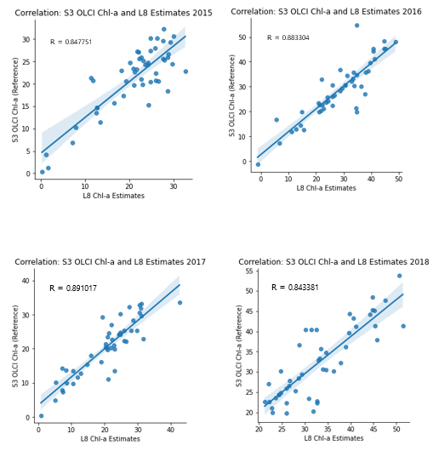
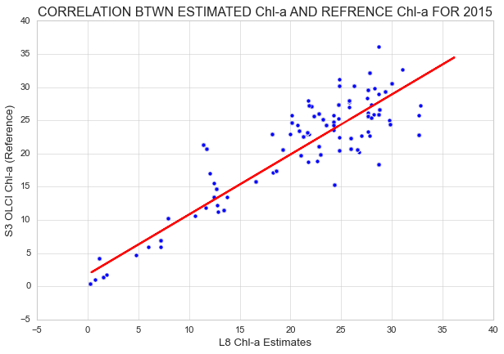
Accuracy Assessment of Chl-a Estimates
R = 0.847751

Slide 12
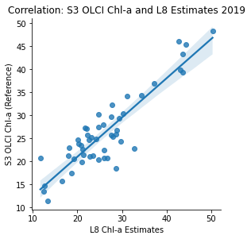
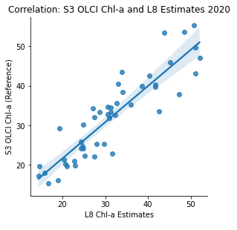
Accuracy Assessment of Chl-a Estimates

Slide 13
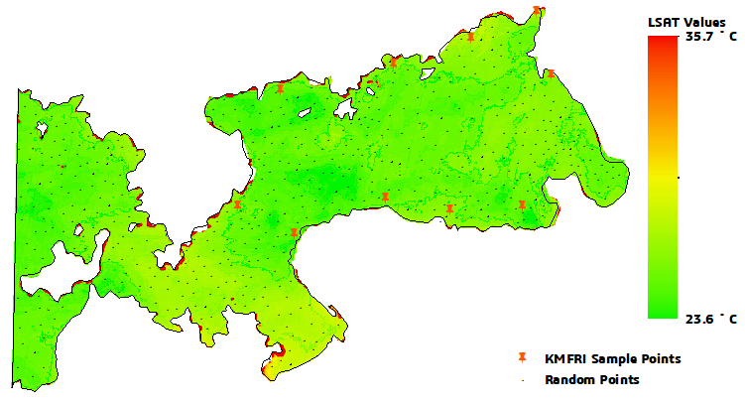
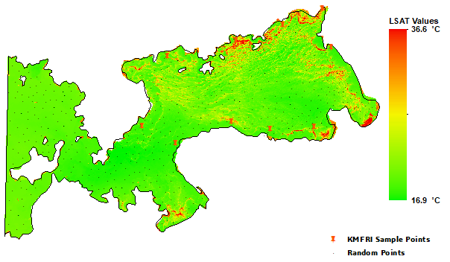
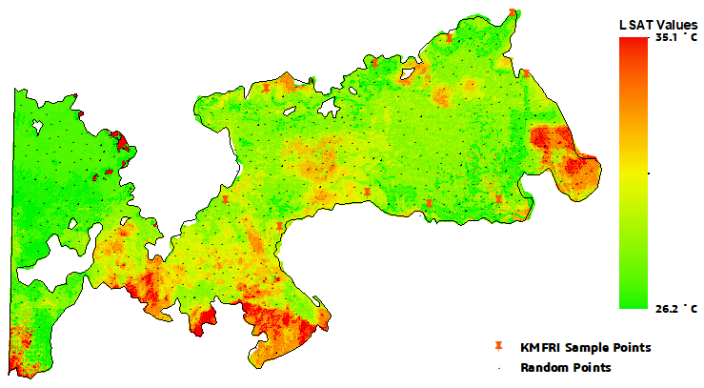
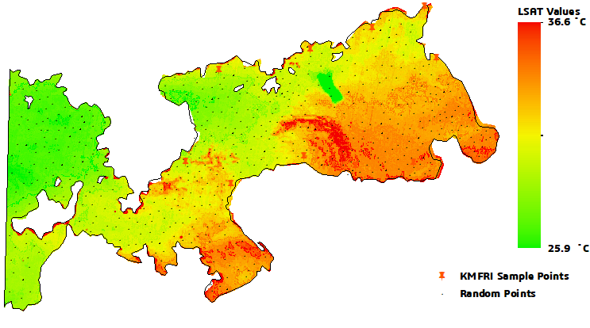
Results (b): High LSAT recorded during bloom Events
12th January 2015 23rd July 2016
04th August 2017 27th January 2018

Slide 14
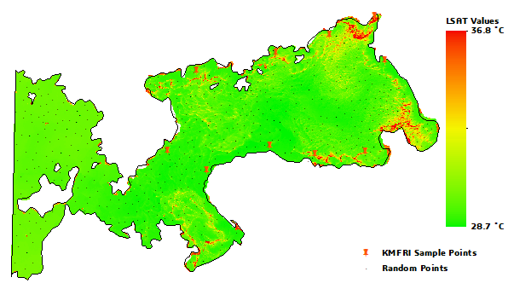
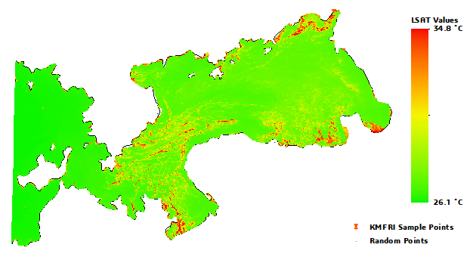
Results (b): High LSAT recorded during bloom Events
18th August 2019 29th August 2020

Slide 15
Accuracy Assessment of LSAT Estimates

Slide 16
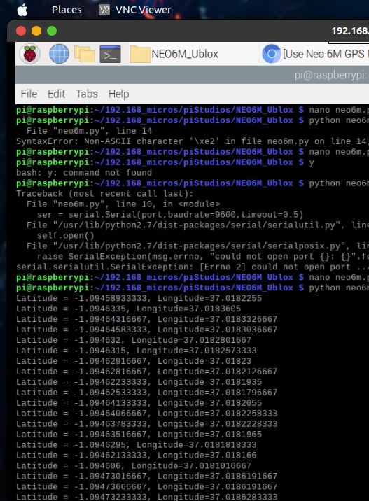
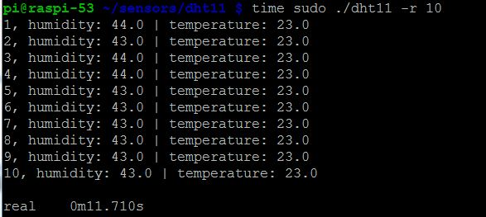
Obtaining GPS Location, Water Temp and Relative Humidity from Sensors.

Slide 17

Thank you for your attention! Questions?

